Slide 1

Practical Research: Planning and Design
Twelfth Edition
Chapter 12
Analyzing Qualitative and Mixed Methods Data
Copyright © 2019, 2016, 2013 Pearson Education, Inc. All Rights Reserved
Notes:
If this PowerPoint presentation contains mathematical equations, you may need to check that your computer has the following installed:
1) Math Type Plugin
2) Math Player (free versions available)
3) NVDA Reader (free versions available)

Slide 2
The Nature of Qualitative Analysis
Combined with data collection
May lead to additional data collection
Largely inductive
Flexible and open-ended

Slide 3
Strategies for Organization and Analysis (1 of 3)
Convert the data into one or more forms that will be easy to organize and analyze
Organize the data in a preliminary, superficial way that will enable you to locate them easily as you proceed.
Identify preliminary categories that are likely to be helpful in coding the data.

Slide 4
Strategies for Organization and Analysis (2 of 3)
Divide the data into meaningful units that will be individually coded.
Apply the initial coding scheme to a subset of the data.
Construct a final list of codes and subcodes, and define each code and subcode as specifically and concretely as possible.
Consider using two or more raters to code the data independently.

Slide 5
Strategies for Organization and Analysis (3 of 3)
Identify noteworthy patterns and relationships among the codes.
Be alert for exceptions, tensions, and contradictions within the data set.
Interpret the data in light of your research problem and questions.

Slide 6
Analysis as a Spiral (1 of 2)
Creswell (2013) has described a data analysis spiral that helps give perspective to qualitative data analysis. In this approach, you go through the data several times using these steps:
Organize the data
Peruse the entire data set several times to get a sense of what it contains as a whole
Identify general categories or themes
Integrate and summarize the data for readers

Slide 7
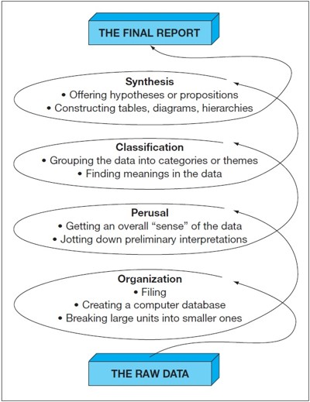
Analysis as a Spiral (2 of 2)
Notes:
Long Description:
The details of the spiral diagram from raw data and final report are as follows: the raw data leads to organization, filing, creating a computer database and breaking large units into smaller ones; perusal, getting an overall sense of the data and jotting down preliminary interpretations; classification, grouping the data into categories or themes and finding meanings in the data; synthesis, offering hypotheses or prepositions and constructing tables, diagram, hierarchies; this leads to the final report.

Slide 8
Researcher-As-Instrument
Qualitative research requires the researcher to make many judgment calls. Because of this, the research is essentially an instrument within the study. These strategies help to maintain credibility and trustworthiness:
Strive for balance, fairness, and completeness
Carefully document your analysis procedures
In your final report, be up front about your personal biases

Slide 9
Analyzing and Interpreting Mixed-Methods Data (1 of 3)
Strategies for analyzing and interpreting data in a mixed-methods study vary depending on the general design of the study.
The mixed methodologist must decide early on whether they will:
give qualitative data and quantitative data equal weight in drawing conclusions
give higher importance to one form of data over the other

Slide 10
Analyzing and Interpreting Mixed-Methods Data (2 of 3)
Data analysis in a mixed-methods study will probably include at least three of the following four steps:
Condensing the data
Depicting general patterns in the data in ways that enable quick visual inspection
Transforming qualitative data into quantitative entities (an optional step)
Systematically comparing and integrating results from the two types of data

Slide 11
Analyzing and Interpreting Mixed-Methods Data (3 of 3)
Some strategies for comparing and integrating results may include:
Creating a two-column table
Identifying concrete examples within the qualitative data that give meaning and depth to the numbers
Count the number of times themes appear in interviews and then compare with frequency counts from survey responses
Divide participants into two or more groups based on demographics and statistically compare frequencies of codes or themes within qualitative data for each group

Slide 12
Systematic Reviews of Qualitative and Mixed-Methods Studies (1 of 2)
Consolidating the results of many quantitative studies is done through meta-analysis. The qualitative and mixed-methods alternative is the systematic review.
In a systematic review, research reports, rather than individual people or other individual entities, are the objects of the study.
The researcher identifies and implements an explicit, rigorous method for selecting and analyzing research reports.

Slide 13
Systematic Reviews of Qualitative and Mixed-Methods Studies (2 of 2)
Researchers conducting a systematic review are likely to:
Conduct an extensive search for studies related to the research problem
Evaluate the quality of each report and then choose to exclude or give less credence to certain reports
Coe the contents of the reports for key ideas, concepts, themes, and/or theories
Perform one or more meta-analyses of any statistical findings reported in the studies

Slide 14

Copyright
This work is protected by United States copyright laws and is provided solely for the use of instructors in teaching their courses and assessing student learning. Dissemination or sale of any part of this work (including on the World Wide Web) will destroy the integrity of the work and is not permitted. The work and materials from it should never be made available to students except by instructors using the accompanying text in their classes. All recipients of this work are expected to abide by these restrictions and to honor the intended pedagogical purposes and the needs of other instructors who rely on these materials.

